Slide 1




Gender
Partner
Dependents
Phone Service
Multiple Lines
Internet Service
Online Security
Online Backup
Device Protection
Tech Support
Streaming TV
Streaming Movies
Contract
Paperless Billing
Payment Method
Churn

Slide 2



Internet Service
Streaming Movies
Contract

Slide 3
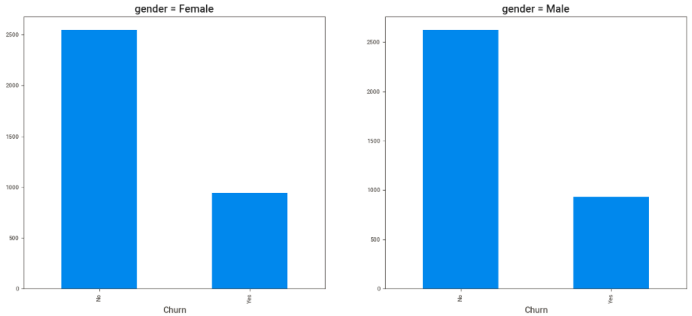
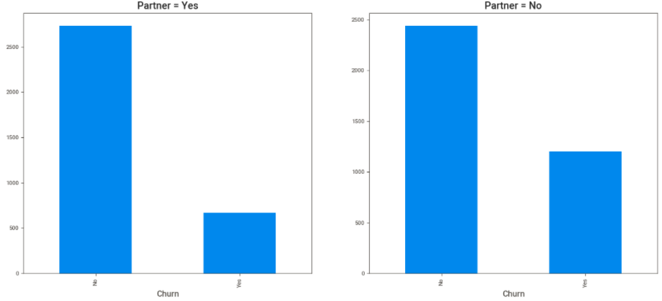
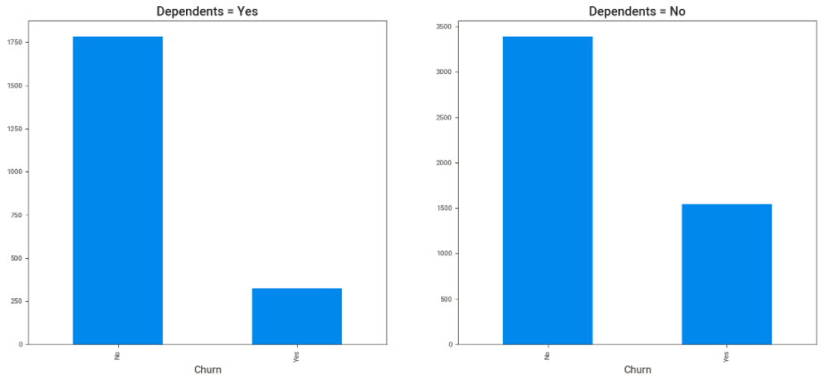
Gender
Partner
Dependents

Slide 4






















Slide 5
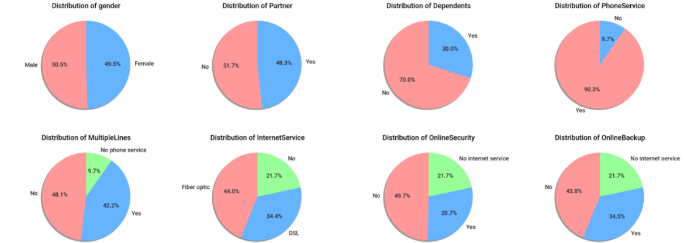
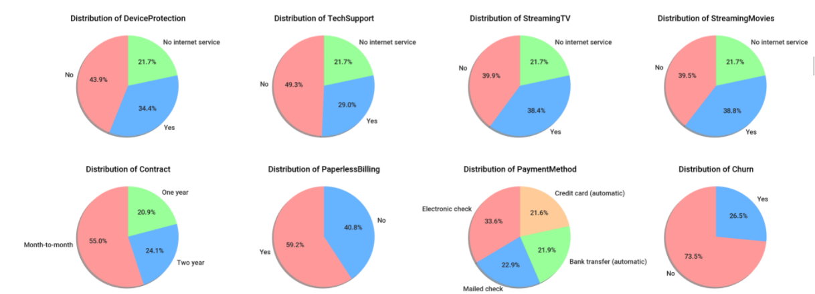

Slide 6
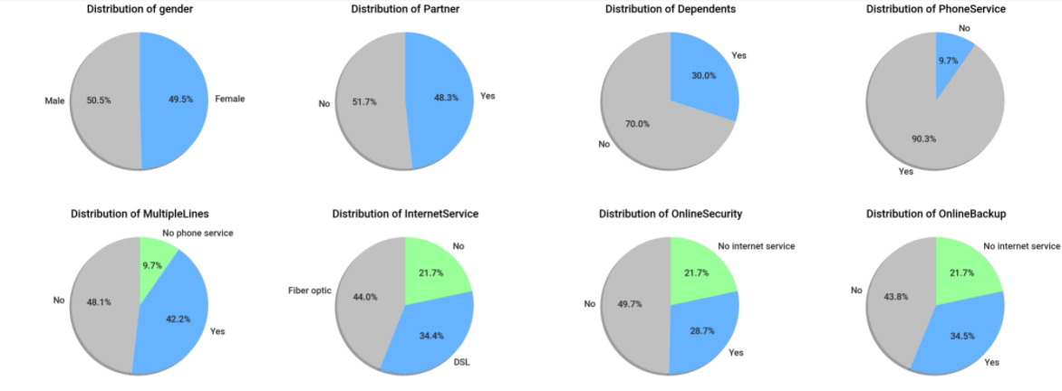
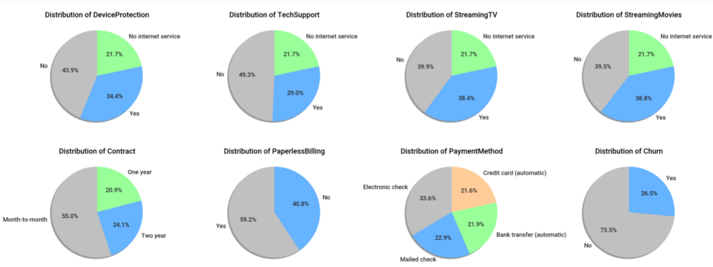

Slide 7
